Slide 1

Digital Library Management System
From C Console App to Web-based Solution
PHASE II: REPORT
Team Name: Coding Monkeys

Slide 2

Initial Concept: C Console App
Technology
Main Features
C Language with GCC and VS Code
File handling, structs, student/admin login
Book issue and return system
Limitations
No graphical interface, limited user experience
Console-only usability

Slide 3
Key Features of Web App
Admin Features
Student Features
Add, Delete, Update Books
View Available Books
Manage Student Records
Check Issued Books
Issue and Return Books
Fine Payment System
Data stored persistently in book.dat and student.dat files

Slide 4
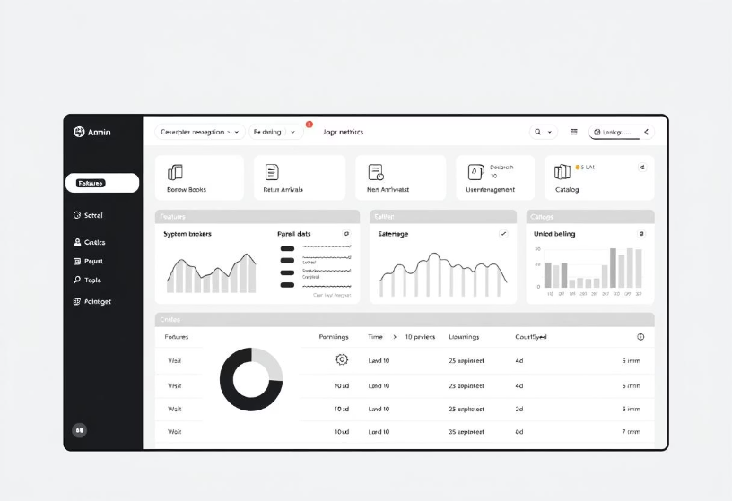
Why Transition to Web-Based System?
Improved User Experience
Accessibility
No remote or web access capabilities before
Console interface lacked intuitiveness and ease
Need for Modernization
Enhance scalability and support multi-user access

Slide 5
Modern Web-Based System Architecture
Backend
Database
Frontend
Authentication
Python Flask framework
SQLite for lightweight data management
HTML, CSS, Bootstrap 5 for responsive UI
Session-based roles: admin and students

Slide 6
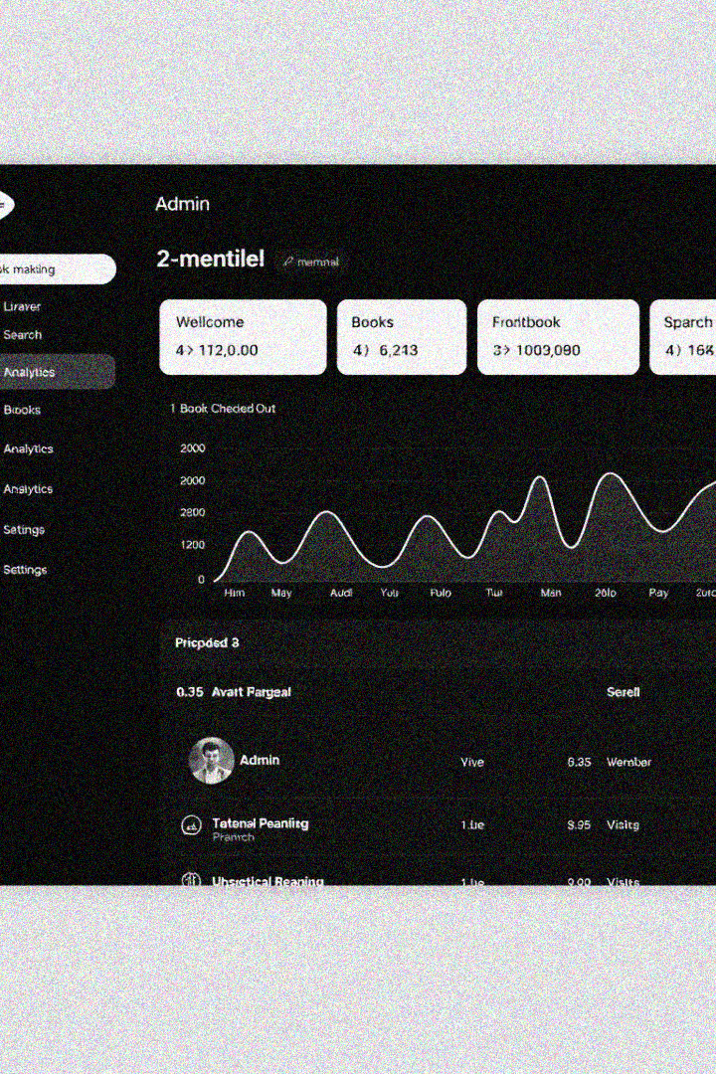




Features of the Web Application
Admin & User Management
Advanced Book Search
Reports & Analytics
Secure Role-Based Access
Clean, modern UI with mobile-responsive design for all users

Slide 7
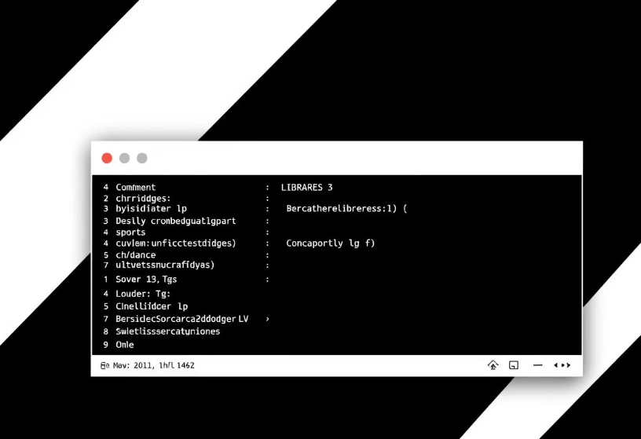
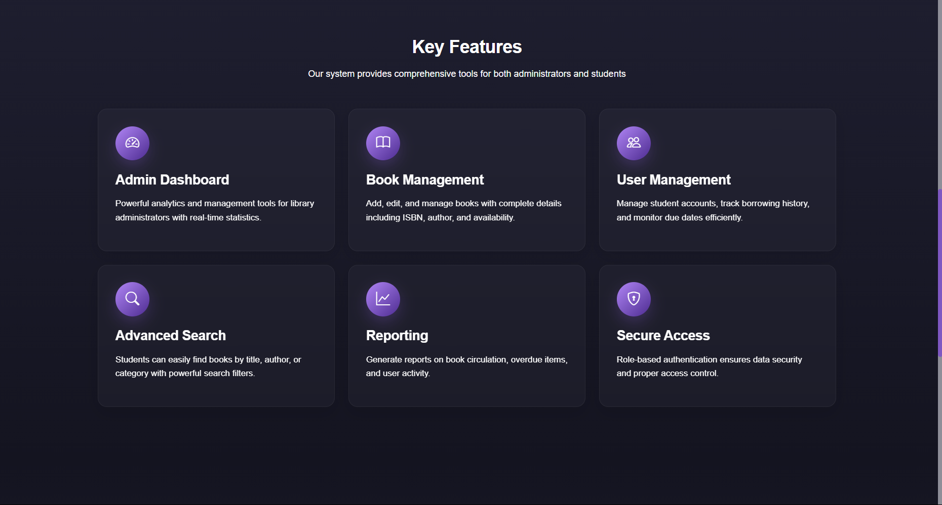
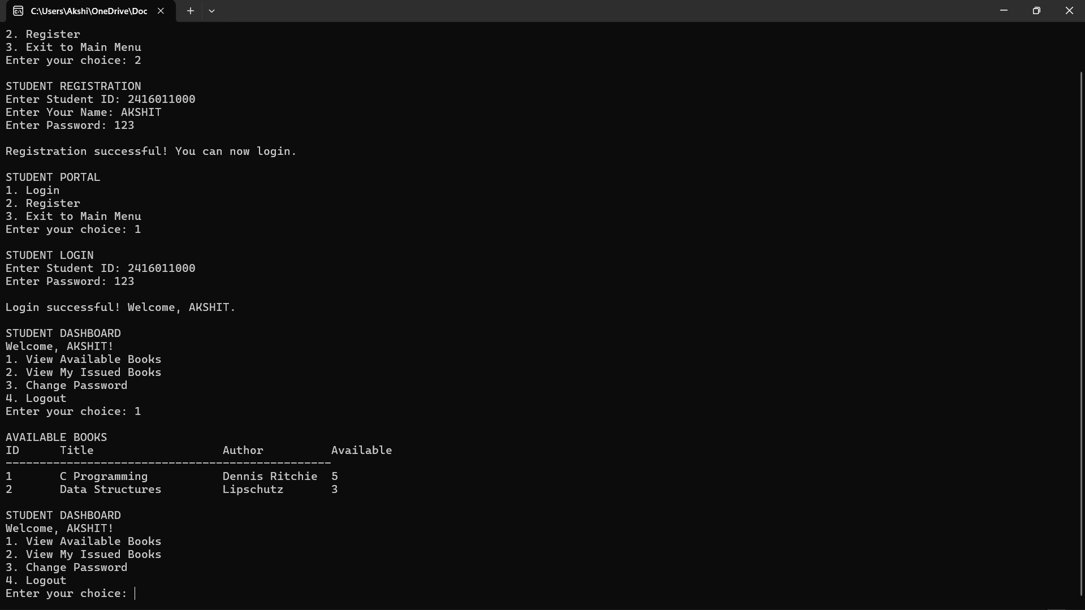
Visual Comparison
C Console Interface
Modern Web UI
Basic text-based layout, minimal interactivity
Intuitive navigation, rich visual elements, and responsiveness

Slide 8

Technical Stack Overview
Languages
Frameworks
Python, HTML, CSS, JavaScript
Flask for backend, Bootstrap for UI, Chart.js for data visualization
Code Quality
Modular design, ready for deployment

Slide 9
Team Contributions
Akshit Kuniyal
Aridaman Nautiyal
Varneet Phakaliyal
Backend optimization and maintaining clean code standards
Integration and debugging across modules
UI enhancements and modular frontend design

Slide 10




Future Plans & Conclusion
Cloud Hosting
Deploy application on cloud infrastructure for scalability
Analytics Dashboard
Integrate real-time reporting for user and book activities
Authentication Upgrade
Use Firebase/Auth for enhanced security and real-time access
Successfully modernized with improved UI/UX, scalability, and readiness for deployment.

